Slide 1
Reflex Arc

Slide 2
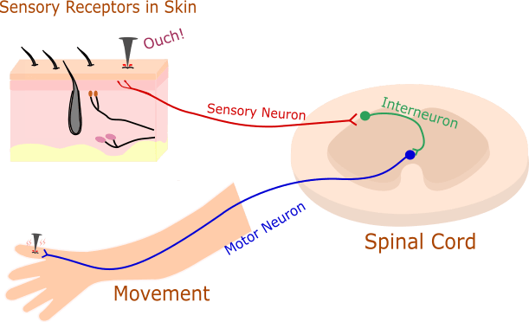
Objectives
In this Lesson you will be introduced to reflexes and the reflex arc.

Slide 3
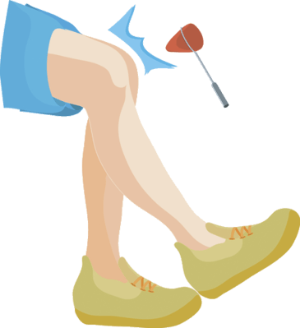
Have you ever wondered why your leg kicks when the doctor taps your knee with that little rubber hammer? It's because of your reflex.
Haven't ever experienced the knee tap? Try it out for yourself! Get your friend to tap you just below your knee cap while sitting with your legs dangling. Your knee should jerk outwards as if you are kicking your friend.

Slide 4

A reflex is an automatic action that your body does in response to something, without you even having to think about it!
Sneezing and coughing are other examples of some of your body's reflexes. They clear your airways of irritating things.
Isn't it amazing how your body can respond to such things, without thinking twice about it?!

Slide 5

Ever wondered WHY your knee automatically kicks out as a response to the hammer? Well my friends, funnily enough, it is all to do with sensory and motor neurons!
Let me explain...

Slide 6
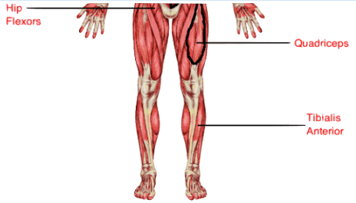
The rubber hammer hit to the knee causes the thigh muscle (quadriceps) to stretch. This stretch sends a signal along a sensory neuron to the spinal cord.

Slide 7
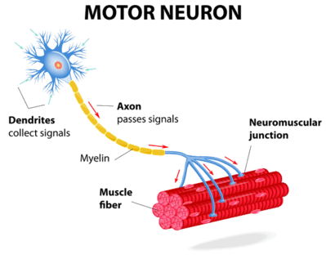
At the spinal cord, (this is an important concept that we will pick up on) the sensory neuron interacts directly with a motor neuron which goes to the thigh muscle. The motor neuron causes the muscle to contract, causing the leg to kick outwards.

Slide 8
Hopefully learning about the knee tap reflex has helped you understand how sensory and motor neurons work together to cause a response.

Slide 9

Other examples of reflexes include coughing, sneezing, ankle jerk (when Achilles is hit), corneal reflex (both eyes blink if cornea is touched), plantar reflex in babies (curl toes when ball of foot is touched), shivering, startle reflex, rooting reflex (infants move towards cheek stroke, to help find milk) and the yawn reflex.
Have you ever found yourself yawning after seeing someone else? This is an example of positive feedback. The yawn reflex affects air intake and also is linked to stretching of muscles.

Slide 10
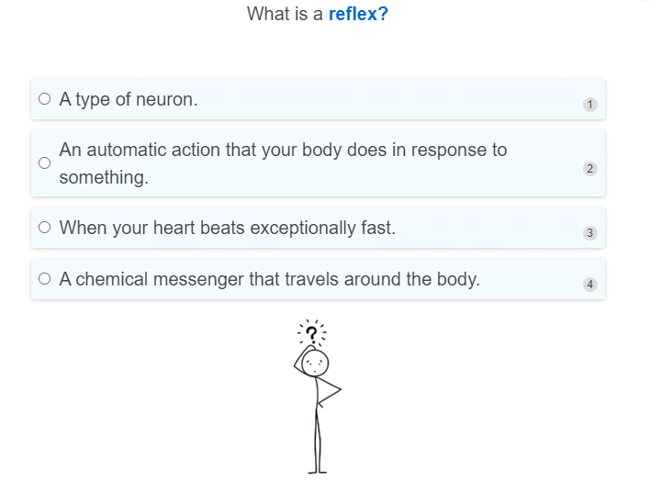

Slide 11
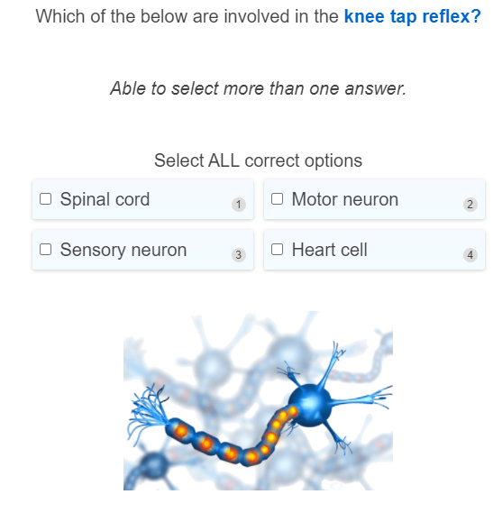

Slide 12
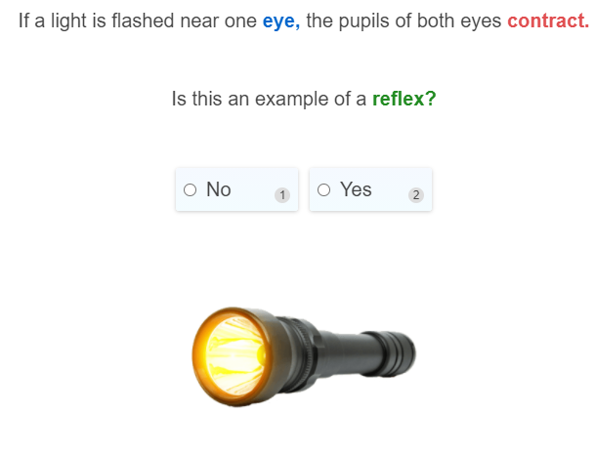

Slide 13
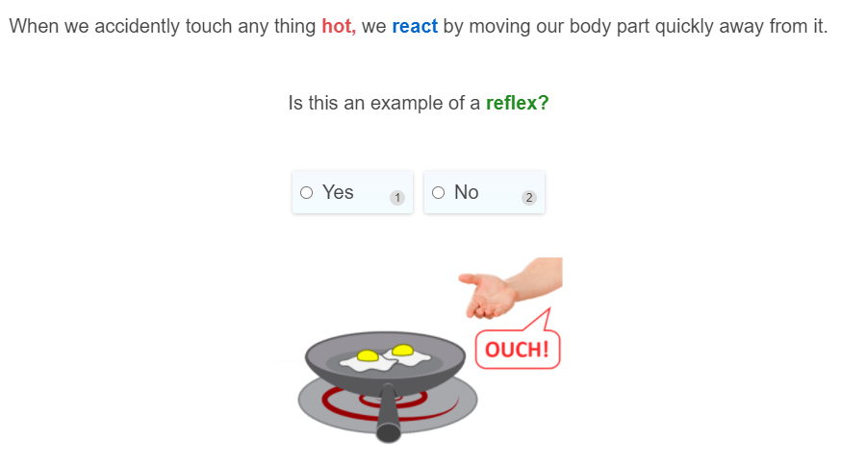

Slide 14
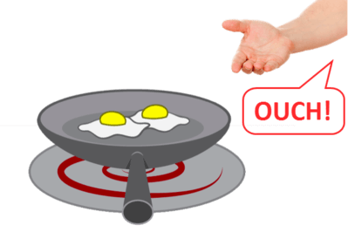
A reflex arc is the nerve pathway which makes such a fast, automatic response possible. It does not matter how smart you are, you will always pull your hand away from a hot stove without having to thinking about it.

Slide 15
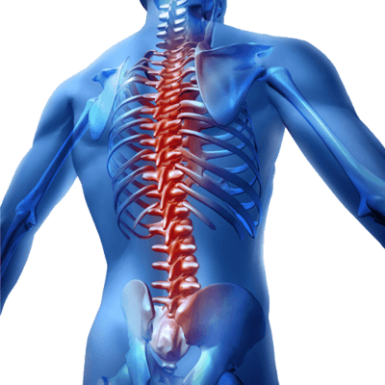
The most defining feature of the reflex arc is that it does not involve the brain! It's an unconscious action.
Most sensory neurons do not pass directly into the brain, but synapse directly with motor neurons in the spinal cord.

Slide 16
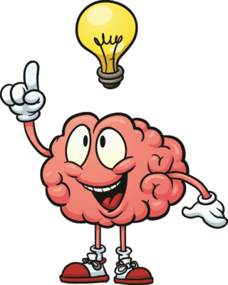
This characteristic allows reflex actions to occur relatively quickly by activating spinal motor neurons without the delay of having to go through the brain. How amazing!

Slide 17
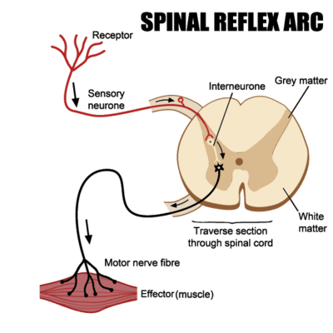
Here is a visual representation of the spinal reflex arc. Don't get too bogged down in the complicated labelling, just notice that the pathway doesn't involve the brain!

Slide 18
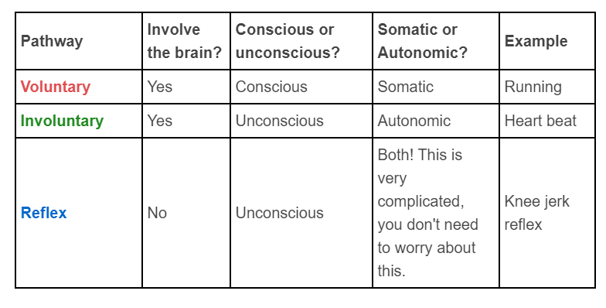
That's a whole lot of confusing information you have just learned! Here is a nice summary table for you.

Slide 19
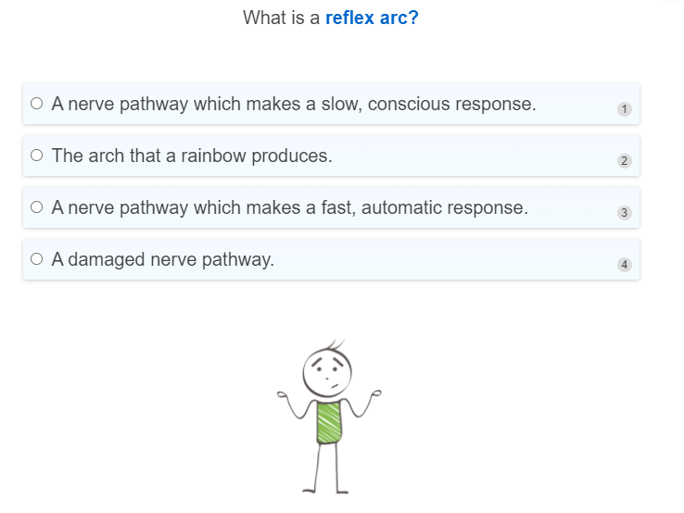

Slide 20
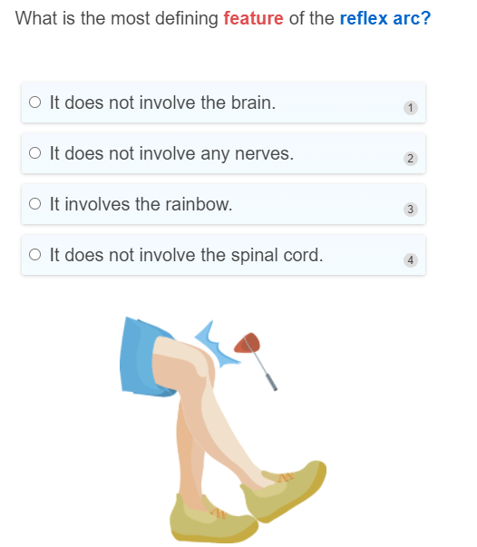

Slide 21
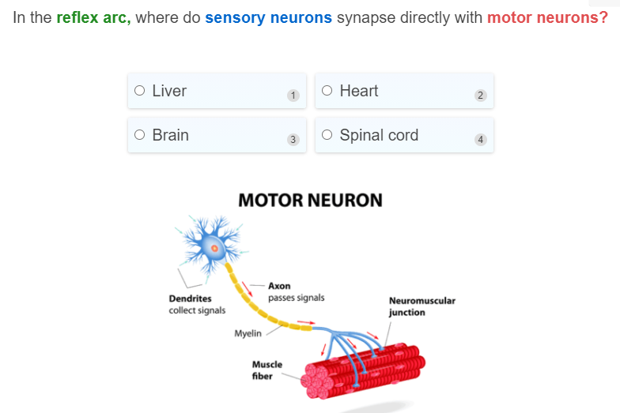

Slide 22
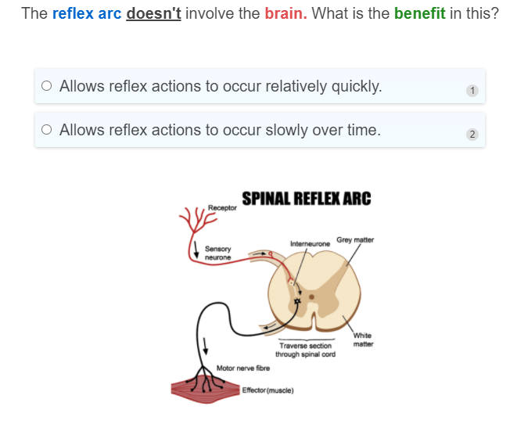

Slide 23
